Slide 1

Embedded Systems I
EE435/EE535
Oregon Institute of Technology
Professor Allan Douglas

Slide 2
Lecture Agenda
“Headless” RPi (follow-up to Lecture#1)
“Headless” BBB (follow-up to Lecture#1)
Cross Compilation under Ubuntu
Installing the Eclipse IDE
Cross Compilation for ARM with Eclipse
Cross Compiling C code on RPi and BBB
Cross Compiling C++ code on RPi and BBB
Eclipse Remote Systems
Lab Assignment #2

Slide 3
Headless RPi
The following operating systems are currently included in NOOBS (New Out Of Box Software ):
Raspbian
Pidora
LibreELEC
OSMC
RISC OS
Arch Linux
Using NOOBS without a keyboard/mouse/monitor really isn't an intended usage case. With NOOBS configured Raspbian…
USB is not enabled default
ssh is not enabled by default
Instead, we should install Raspbian (latest version) on our SD Card
This is best for “headless” operation
You can download the .img file here https://www.raspberrypi.org/downloads/raspbian/

Slide 4
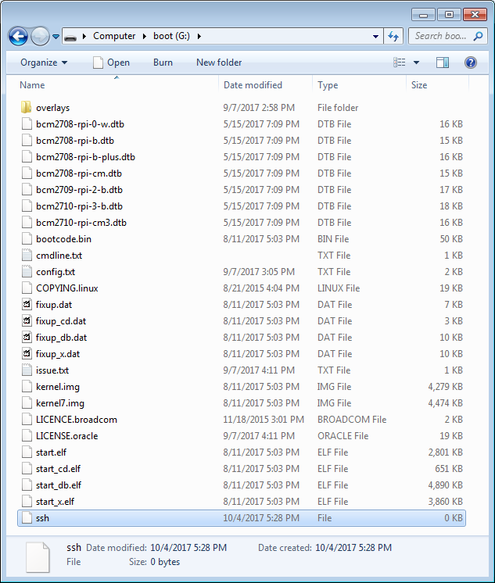
Headless RPi
Download Etcher for you PC
https://etcher.io/
Flash the image on the SD Card
Create a blank file called ssh in the root folder of the SD Card. No extension. You can do this with the Nano text editor.
Unmount the SD Card from your PC
Install SD Card in RPi
Connect RPi via wired Ethernet to your Router
Power-up RPi with USB cable

Slide 5
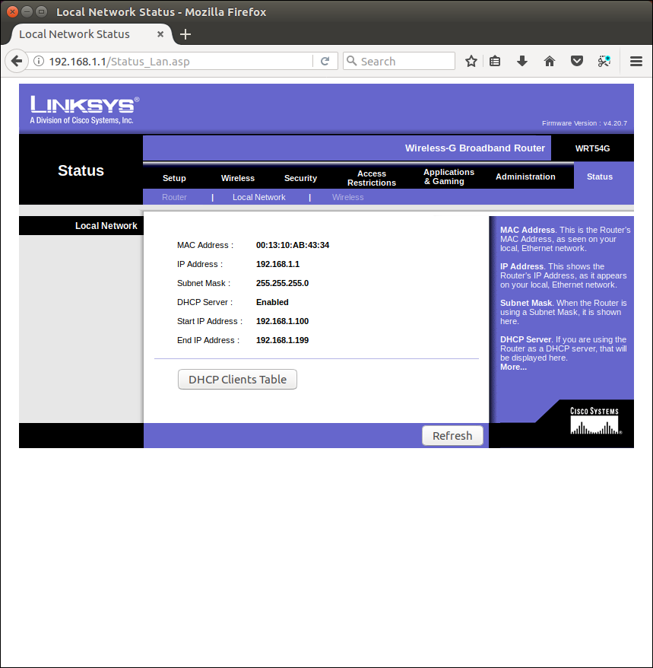
Ethernet Router
Open your Ethernet Router webpage (usually at 192.168.1.1)
Confirm that DCHP is enabled
Locate the DHCP Clients Table

Slide 6
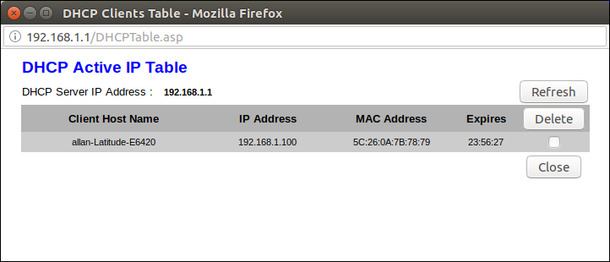
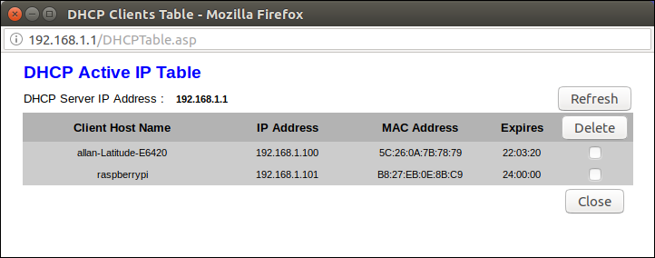
DHCP Clients
Initially, you will only
see your laptop.
After the RPi boots
and you click refresh,
you can see the RPi.
The dynamically
assigned IP address is
192.168.1.101

Slide 7
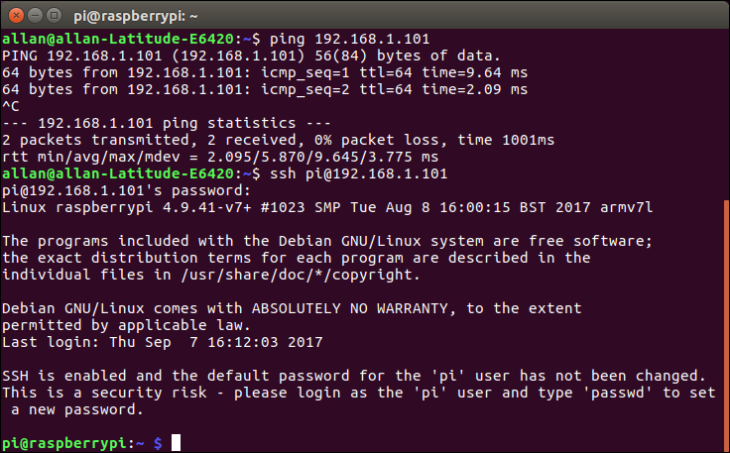
Headless RPi
Now that we know the RPi IP address, we can use ping to make sure we can a good connection from the laptop. Make sure you see a response.
Finally, we can ssh into the RPi
Password is
raspberry

Slide 8
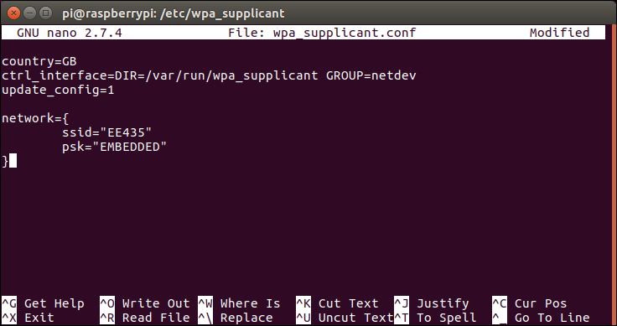
Connecting to WIFI
Now that we can ssh to the RPi through wired Ethernet with dynamic IP address assignment (DHCP), we need to connect to Wi-Fi.
Change directory
Edit this file
Add these lines and
save (Write Out)
Step 5 on this website goes through the details https://caffinc.github.io/2016/12/raspberry-pi-3-headless/
The WiFi router we use for this class
is called EE435. The password to
connect is EMBEDDED. Of course, this
may be different for your personal WiFi
network.

Slide 9
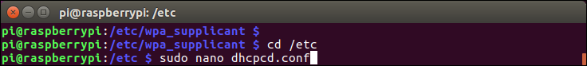
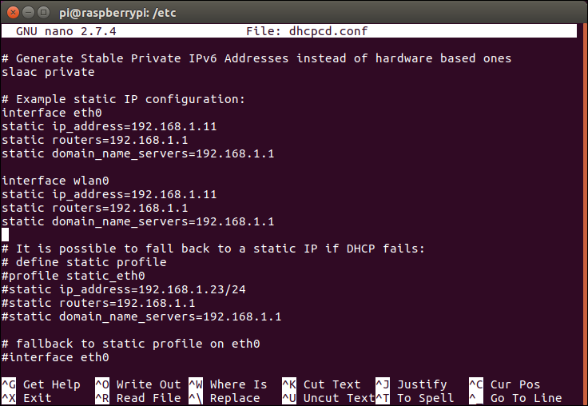
Setting Static IP Addresses for RPi
Next, we set static IP Addresses based on class assignment. The spreadsheet with your IP addresses has been posted on Canvas.
Change directory
Edit this file
Wired Ethernet
Add these lines and
save (Write Out)
Wi-Fi
Now cycle power to reboot

Slide 10
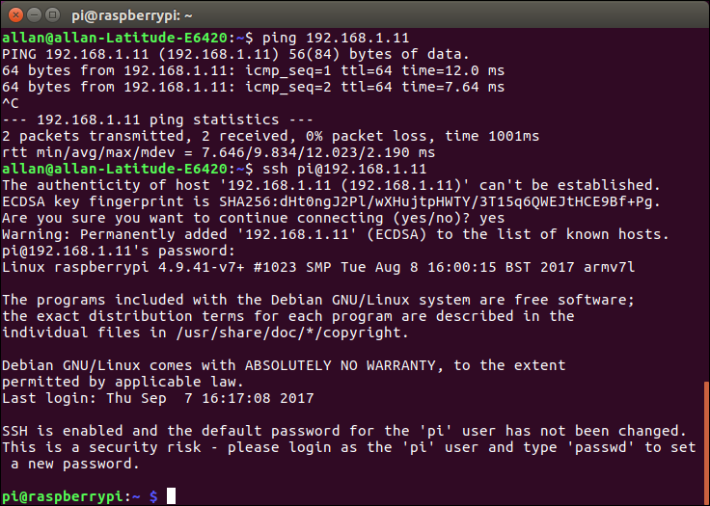
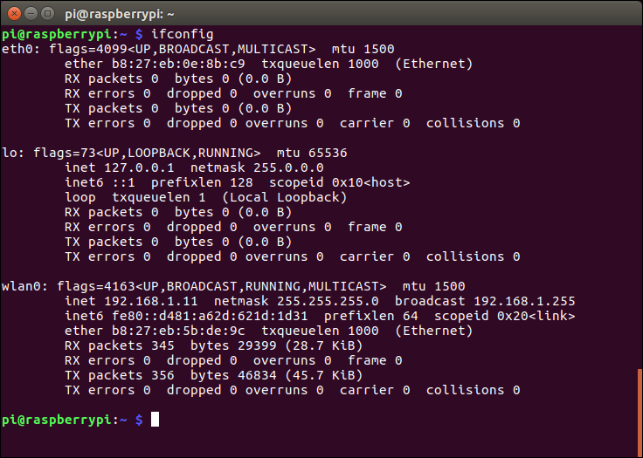
Verification (Wireless Connection)
We are connected to the RPi
Our connection is WiFi (wlan0)
Ethernet cable is unplugged

Slide 11
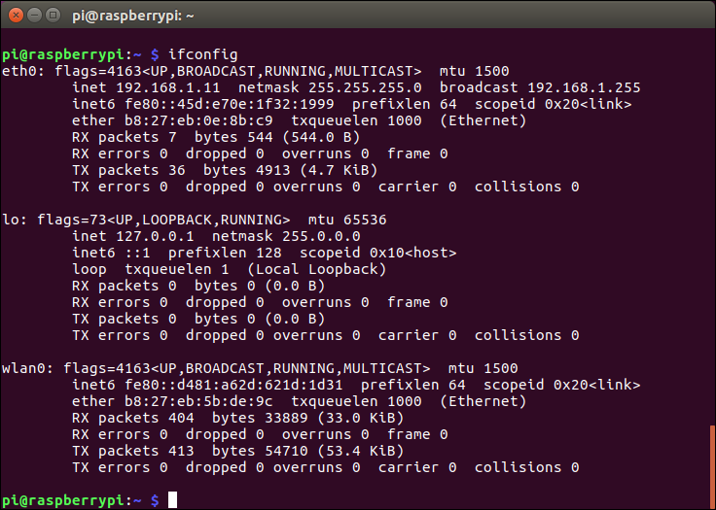
Verification (Wired connection)
We are connected to the RPi
Our connection is wired Ethernet (eth0)
Ethernet cable is plugged in

Slide 12
Connecting the RPi on your home network
Assuming you want to disconnect from the EE435 wireless network, and restore the RPi so that you can work on your home network…
Modify the wpa_supplicant.conf file and change the SSID to your home network, change the PSK to your password.
Comment out the static IP addresses in the dhcpcd.conf file.
Power down the RPi
When you power-up the RPi at home, the RPi will connect to your home network and have its dynamic address assigned by DHCP in your router.

Slide 13
Headless BBB
Connecting to the BBB is not as difficult since Debian has ssh enabled by default.
Connect the BBB to your router with a wired Ethernet patch cable.
The default IP address is 192.168.7.2
ssh to the BBB with the command ssh debian@192.168.7.2
The password is temppwd
Now you can change the static IP address
Change directory
Edit this file

Slide 14
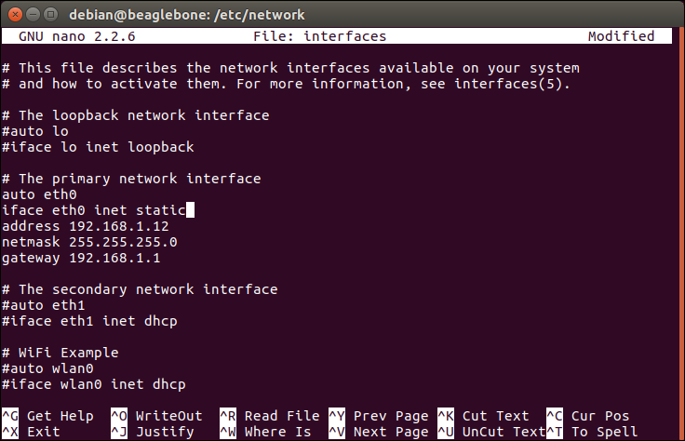
Setting Static IP Addresses for BBB
Wired Ethernet
Modify these lines and
save (Write Out)
Now cycle power to reboot

Slide 15
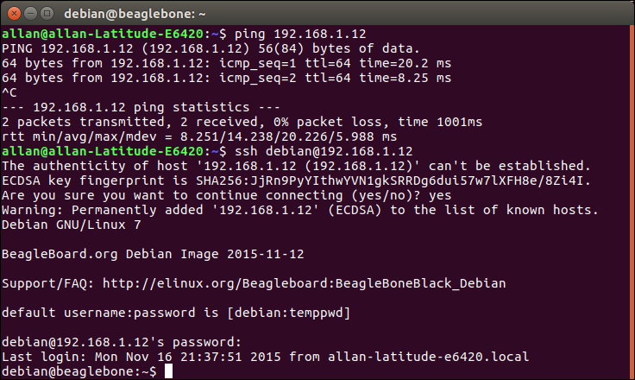
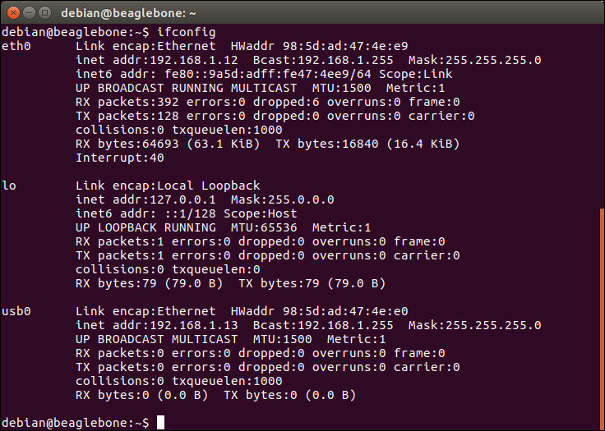
Verification (Wired connection)
We are connected to the BBB
Our connection is wired Ethernet (eth0)
Ethernet cable is plugged in

Slide 16
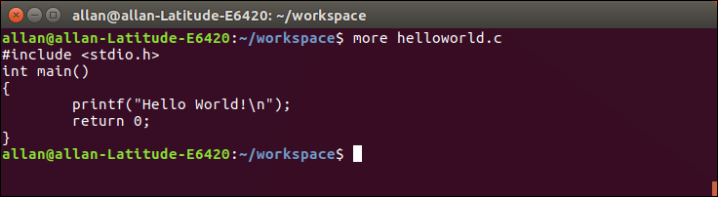
Cross-Compilation
On your Ubuntu laptop
Create a directory called workspace
Use gedit or nano to create a “Hello World!” C application
After writing this simple C code, you can review the file at the Linux prompt with the more command.

Slide 17
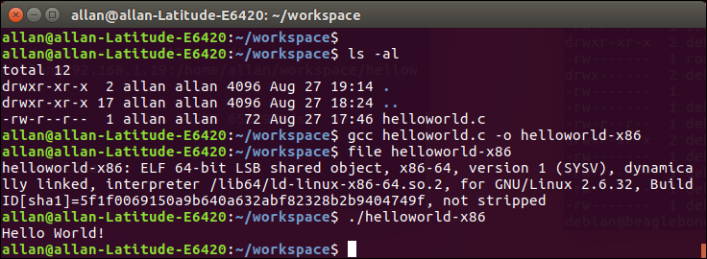
Compile Code to x86 machine
Compile for the host machine (x86-64) with the gcc compiler
This is part of Ubuntu
Use the file command to get information about the compiled executable file.
To execute your compiled code, type ./helloworld-x86
Executable

Slide 18
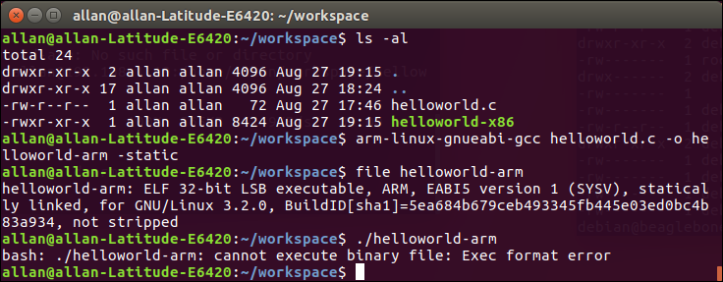
Cross-Compile for ARM
First, we need to install the ARM compiler
sudo apt-get install gcc-arm-linux-gnueabi binutils-arm-linux-gnueabi
Recompile using the new compiler arm-linux-gnueabi-gcc
Libraries must
be statically
linked
Check the executable with the file command
Try to execute this on you x86 machine (laptop). An error is expected since helloworld-arm was compiled for an ARM processor and we are running on a x86-64 machine. Let’s copy to RPi and try again.

Slide 19
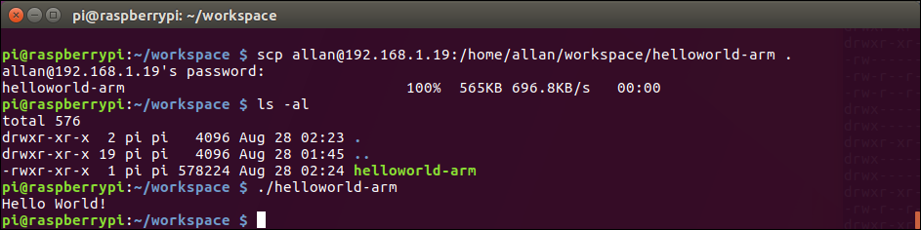
Cross-Compile for ARM
ssh to the RPi
Use the scp command to copy the executable file from your laptop to the RPi.
Now the executable runs as expected on the ARM processor!
Allan’s old IP address (before class
assignment). This should be your
assigned static IP address.

Slide 20
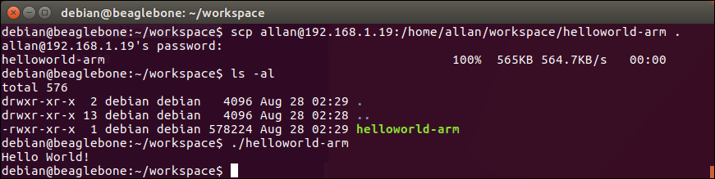
Cross-Compile for ARM
Now let’s copy to the Beaglebone Black and execute the code.
ssh to the BBB
Use the scp command to copy the executable file from your laptop to the BBB.
The executable runs as expected on the ARM processor on the BBB!

Slide 21

Integrated Development Environments
Writing code in a simple text editor and compiling at the Linux command prompt is fine, but most professionals use an Integrated Development Environment (IDE).
One of the most popular is called Eclipse.
It is a free download for many different platforms.
https://www.eclipse.org/ide/

Slide 22
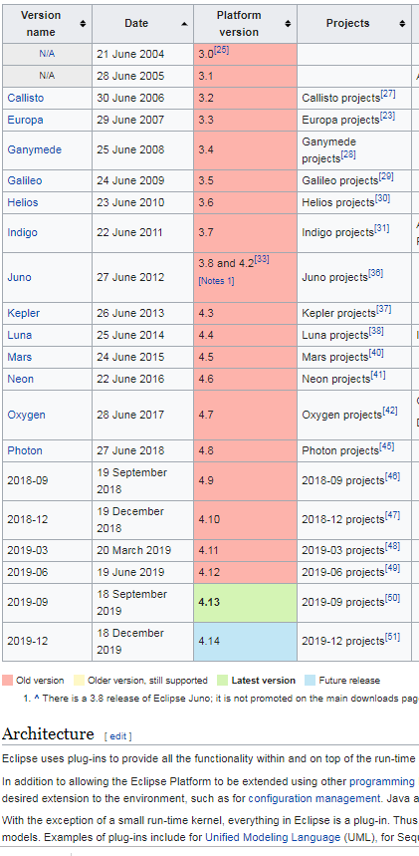
Eclipse Versions
For this class, we should be using the
latest release. Some slides may
shown screenshots from earlier releases.
Use this link to see the latest version:
https://en.wikipedia.org/wiki/Eclipse_(software)

Slide 23
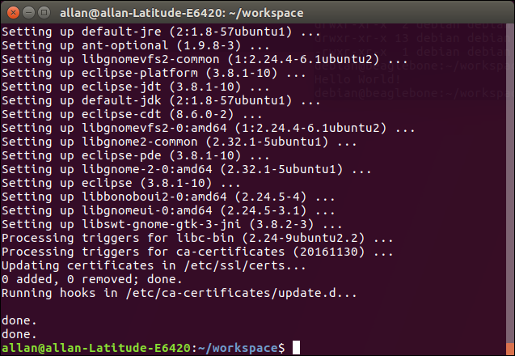
Installing Eclipse IDE with C/C++
Installing Eclipse IDE with C/C++ plugin(or CDT) in Ubuntu (your laptop)
sudo apt-get install eclipse eclipse-cdt g++
Downloaded 255MB
~10 minutes

Slide 24
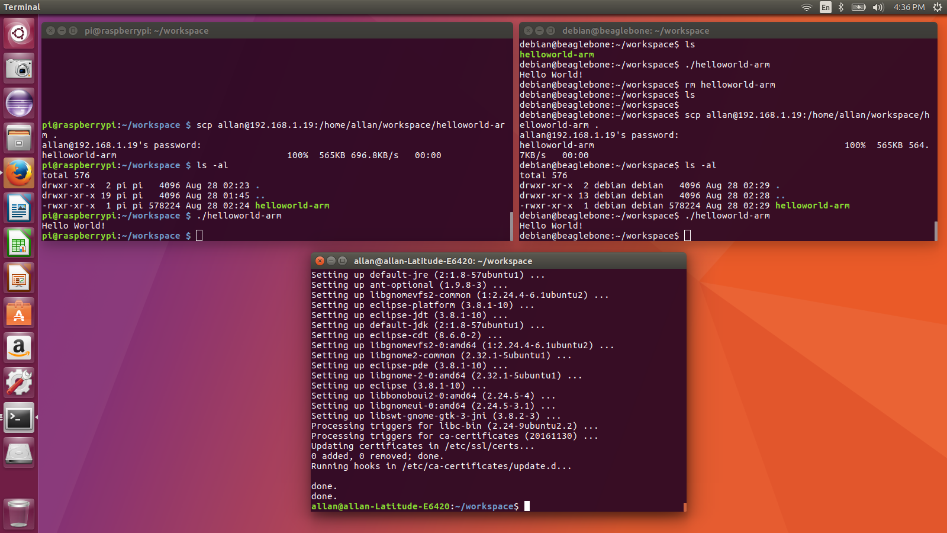
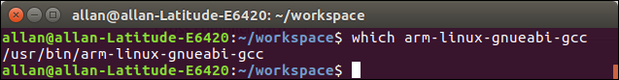
Eclipse IDE with C++
Create a
new desktop
icon
Verify that you have the cross compiler installed with the which command.

Slide 25
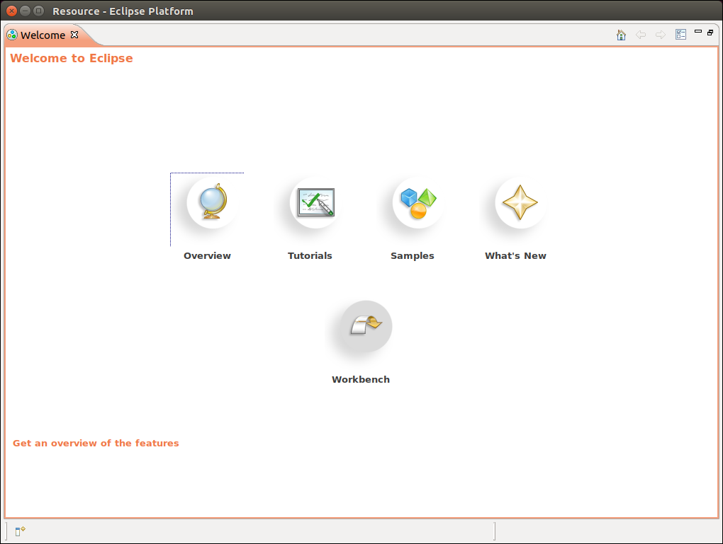
Eclipse Startup Window
Start Eclipse on your laptop by double-clicking the icon.
Select
Workbench

Slide 26
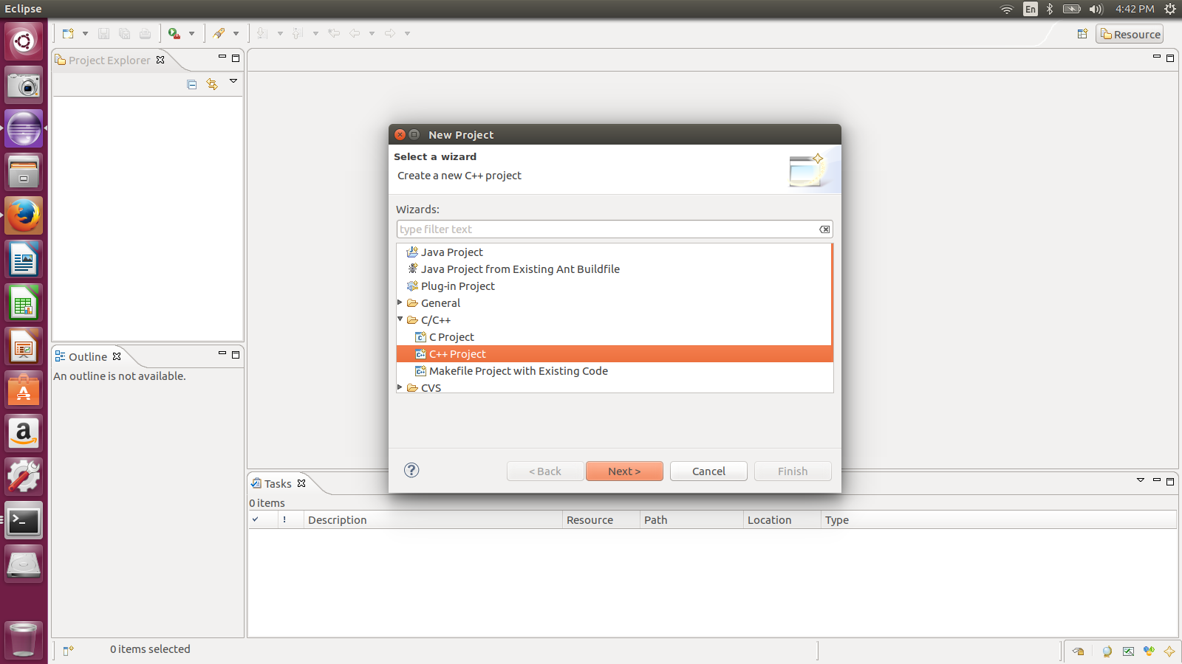
Eclipse – Create a New Project
Use C Project

Slide 27
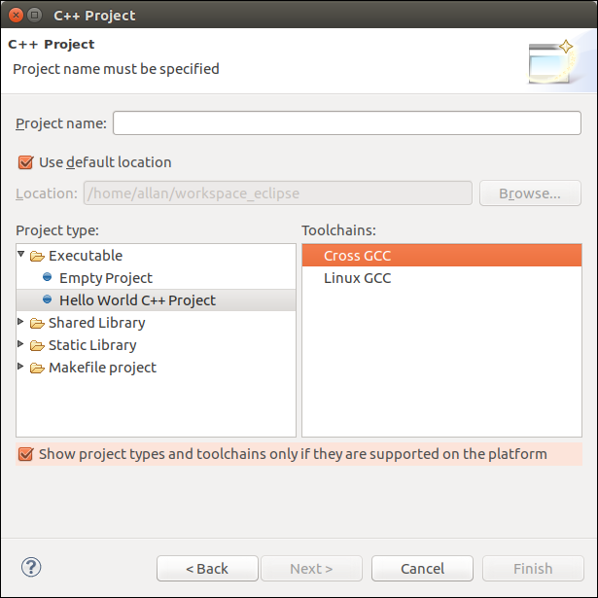
Eclipse – Select a Toolchain
Cross-compile
C Project

Slide 28
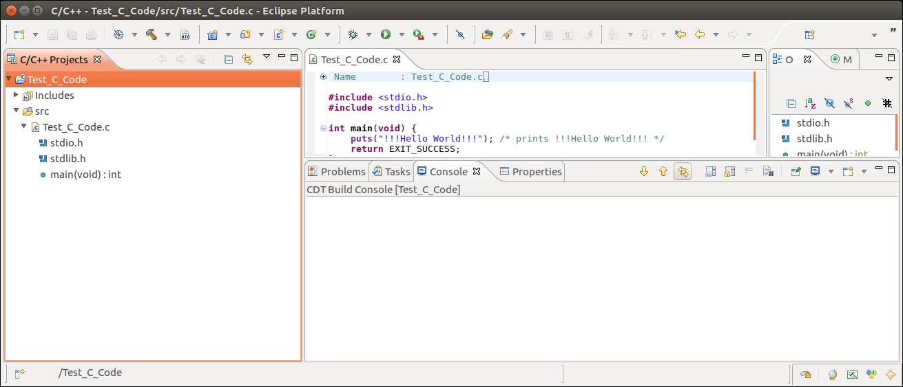
New Hello World Project
Hello World example
Right click for
Project Settings

Slide 29
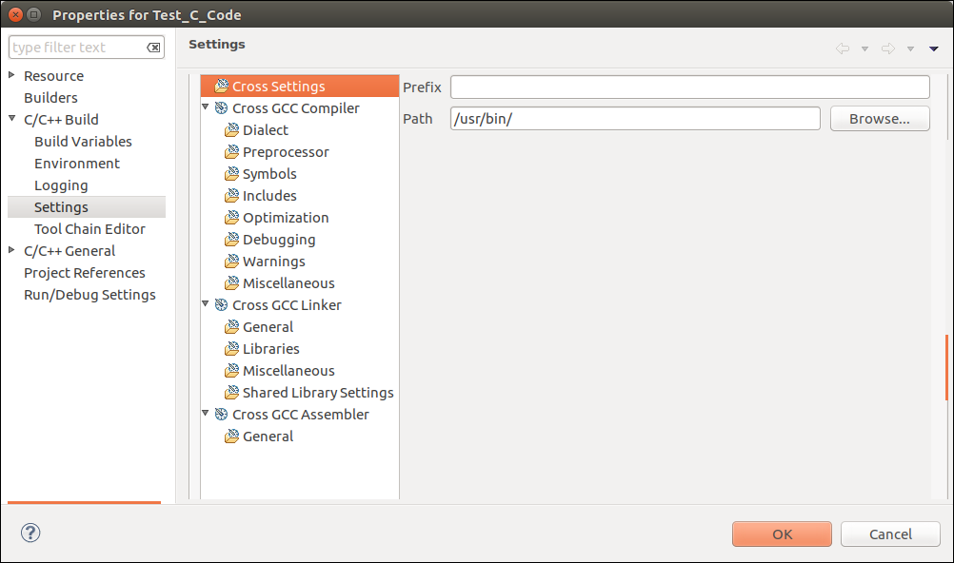
Project Settings

Slide 30
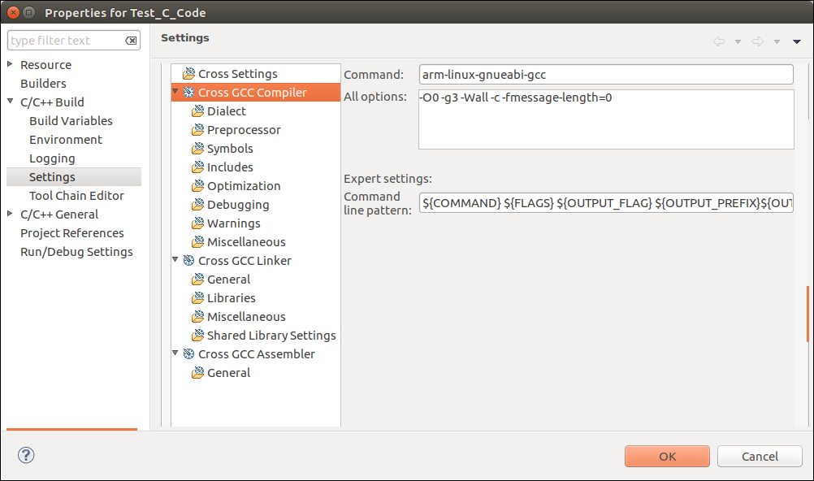
GCC Compiler Settings
Compiler

Slide 31
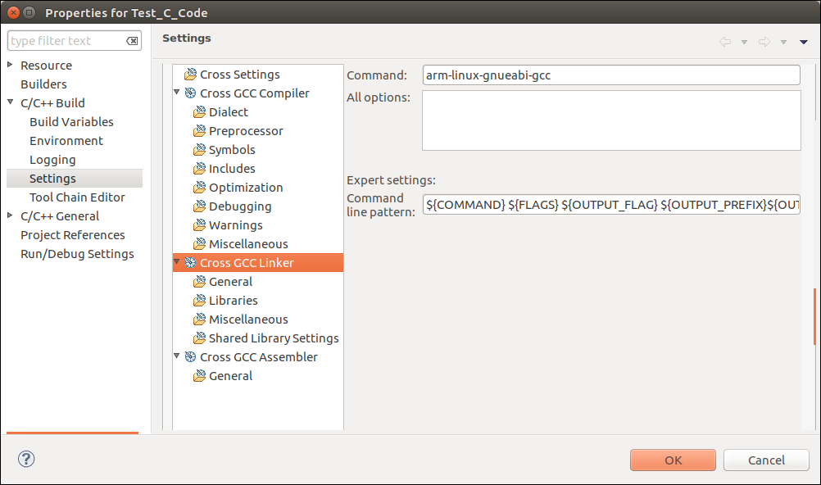
GCC Linker Settings
Linker

Slide 32
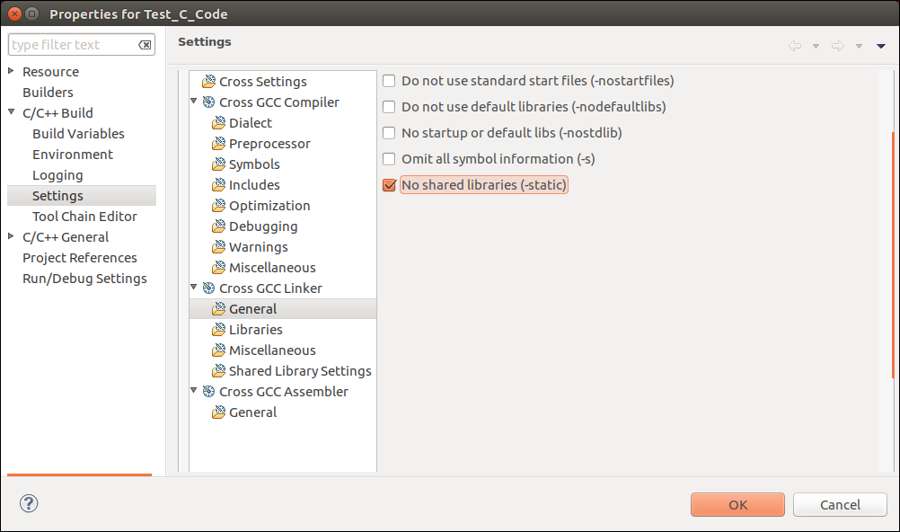
GCC Linker Settings
Libraries should be static

Slide 33
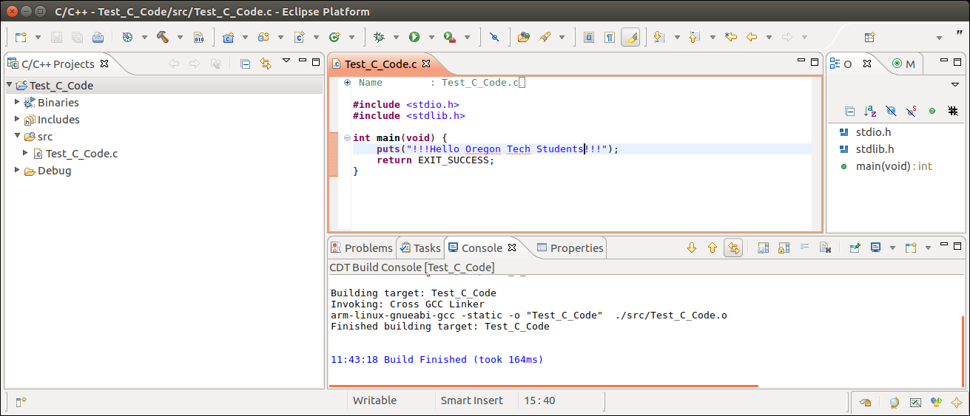
Cross Compiling
Click here to
compile and link
Modified file
Built successfully

Slide 34
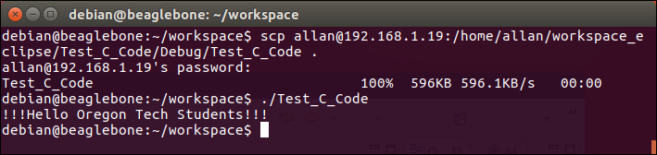
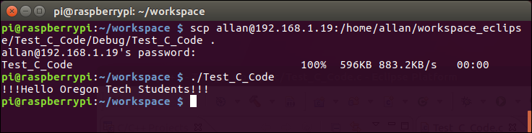
Transfer to Remote Embedded Systems
BBB
RPi
Success!

Slide 35
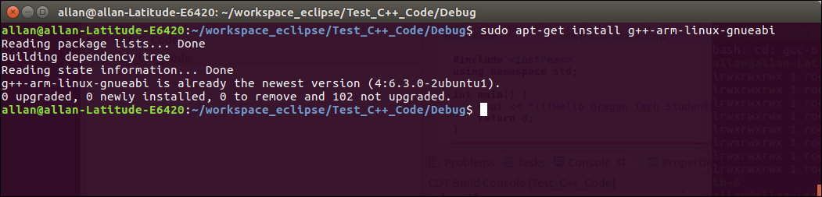
Now let’s try a C++ Project
Install g++ compiler for ARM
Already installed on my Linux machine…

Slide 36
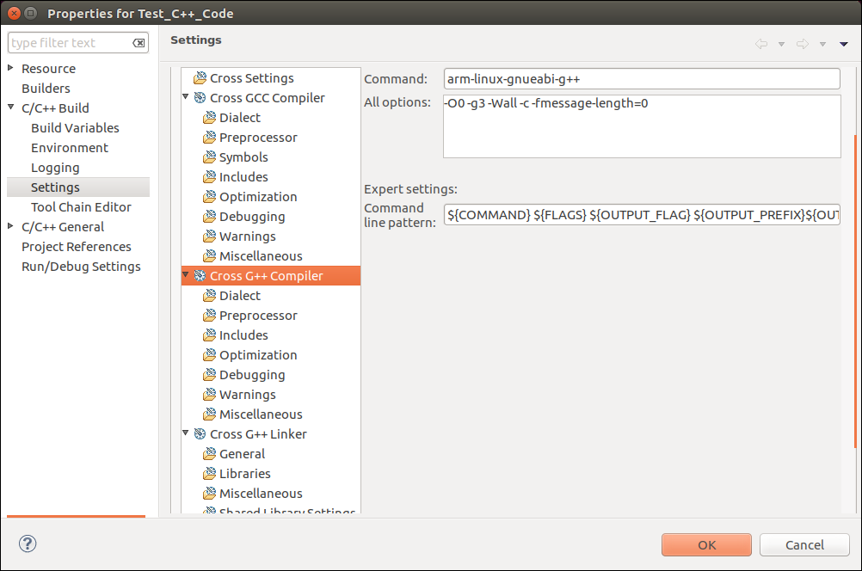
G++ Compiler Settings
Compiler

Slide 37
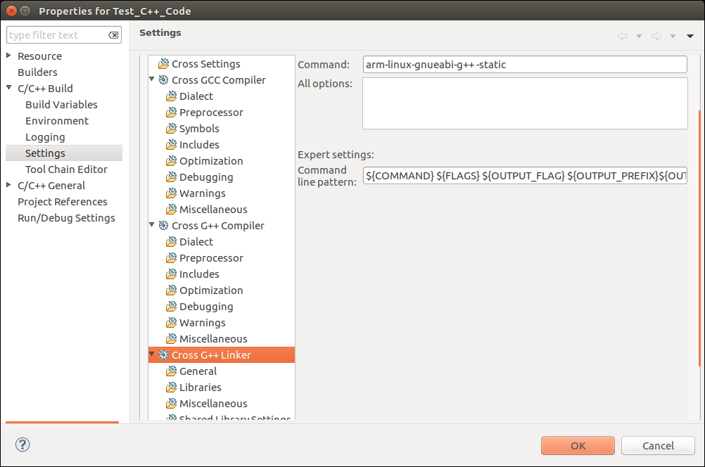
G++ Linker Settings
Static
libraries

Slide 38
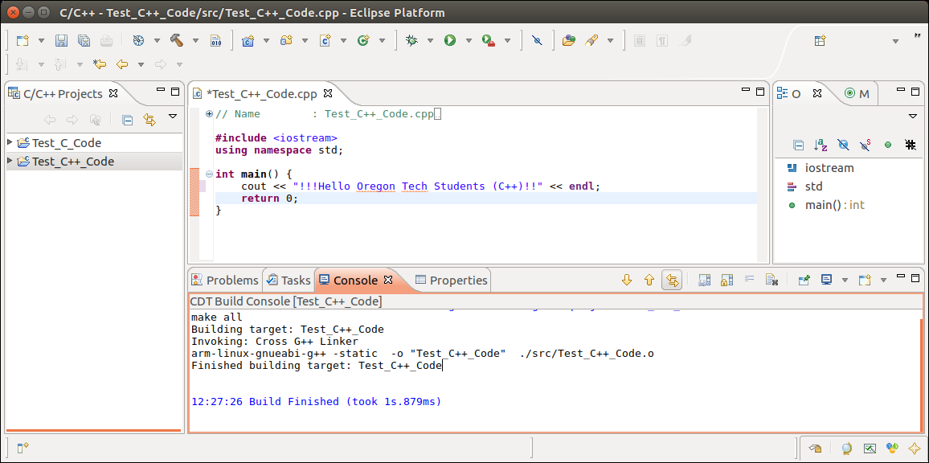
New C++ Hello World Project
Create a new project
C++
Built successfully

Slide 39
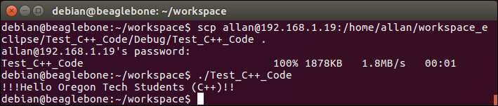
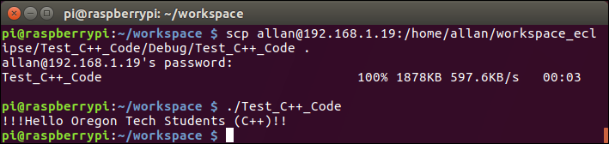
Execution on Both ARM Processors
BBB
RPi

Slide 40
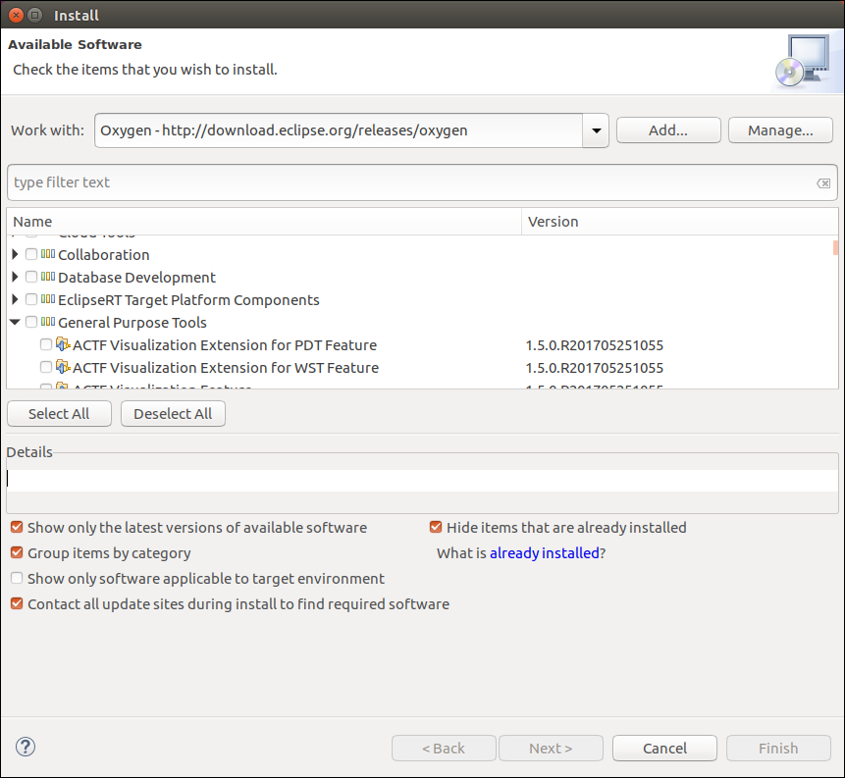
Eclipse (Remote Systems)
Start Eclipse
Select Help->Install New Software…
Install the Remote System Explorer User Actions
Work with Oxygen release
General purpose tools
If you want to Cross Compile and automatically upload your
executable files to the RPi and BBB, you may need to follow Eclipse
tutorials on the Internet. This can be a bit confusing to setup.

Slide 41
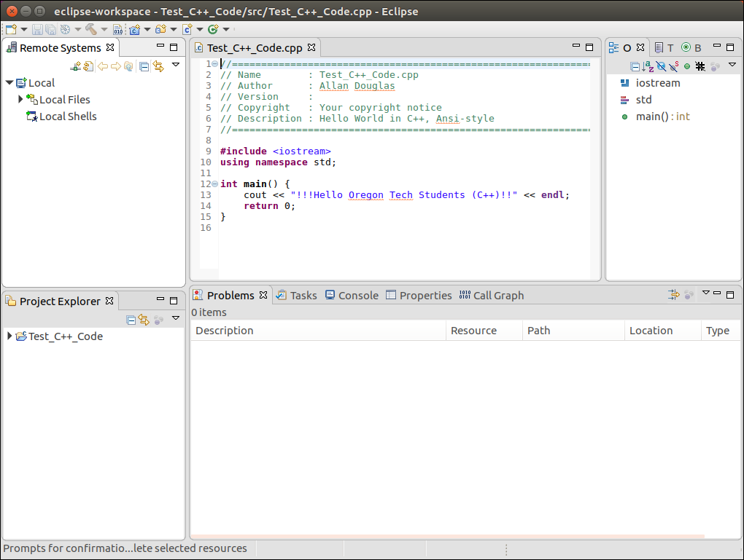
Eclipse (Remote Systems)
Select Window->Show View-> Other->Remote Systems-> Remote Systems
Select
New Connection
Move the Remote Systems window

Slide 42
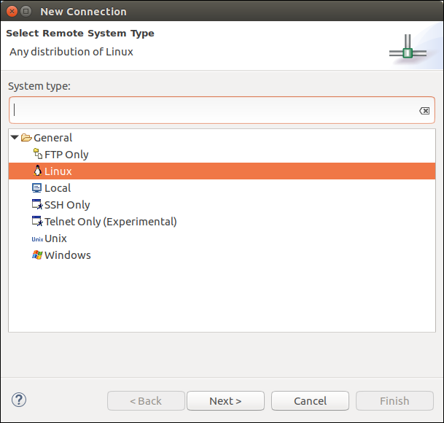
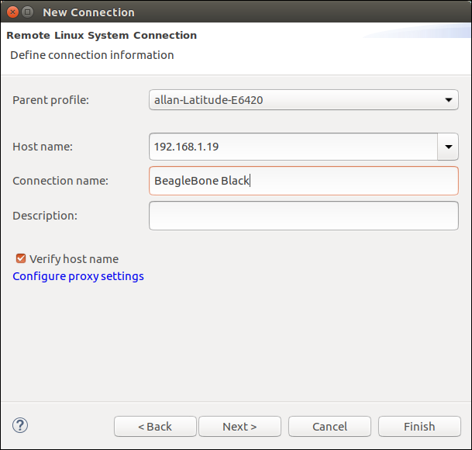
Eclipse (Remote Systems)
Select Linux
Use the IP address of the remote device
Click next…
Old BBB IP address
(before class assignment)

Slide 43
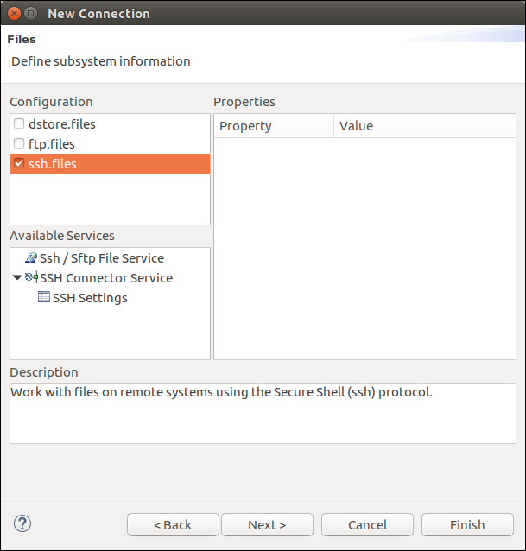
Eclipse (Remote Systems)
How should we transfer files?
Select ssh files
Click Finish…

Slide 44
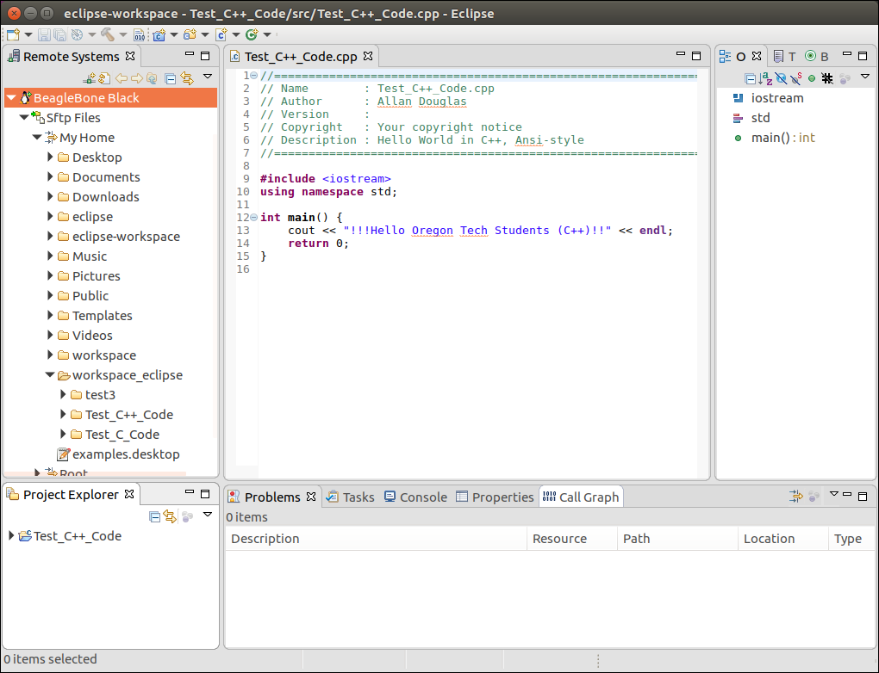
Eclipse (Remote Systems)
BeagleBone Black
Now you can drag and drop files
to the Remote System (BBB)

Slide 45
Lab Assignment #2 – Not assigned yet
Lab Objectives
The objective of this lab is to install and configure the Eclipse Integrated Development Environment (IDE), compile simple applications with C and C++ compilers for ARM platforms, setup Eclipse Remote Systems for the RPi and BBB, and learn how to interact with GPIO on the RPi and BBB through a Linux terminal.
Part 1 – Installing Eclipse and Cross Compiling
Install the Eclipse (latest version) IDE on your Ubuntu laptop and verify that the software runs as expected.
Install the C compiler for ARM processors on your laptop under Linux.
Configure Eclipse for the C compiler.
Write “Hello World!” in C, cross compile for ARM, copy the executable to the RPi, and execute the code on the RPi.
Install the C++ compiler for ARM processors on your laptop under Linux.
Configure Eclipse for the C++ compiler.
Write “Hello World!” in C++, cross compile for ARM, and execute the code on the RPi.
Repeat steps 2-7 for the BBB.

Slide 46
Lab Assignment #2
Part 2 – Eclipse Remote Systems
Install the Remote Systems add-on for Eclipse.
Configure the Remote System to connect to the RPi with ssh.
Confirm that you can transfer files to and from the Remote System through the Eclipse GUI.
Repeat steps 1-3 for the BBB.
Part 3 – Interacting with GPIO
Independently research how to manipulate GPIO pins on the RPi from the Linux command shell (terminal).
Use ssh to connect from your Laptop to the RPi.
Execute Linux commands to the turn on and off the LEDs on the RPi.
Include pictures of your RPi with the LEDs on and off.
Repeat steps 1-4 for the BBB.
Make sure to use the on-board LEDs.

Slide 47
Lab Assignment #2
Lab Report Guidelines
Include the following sections in your Lab Report: Introduction, Parts 1-3, and a Conclusion.
Assume that the individual reading your Lab Report has not read this document. Explain each part, state what you are attempting to accomplish, and demonstrate how you completed each part.
Include screenshots that clearly show each part of the lab. Your objective is to demonstrate that you successfully accomplished each task.
Include a complete listing of your source code (C/C++/Python) in your Lab Report.
In your conclusion, state which parts of the lab were challenging, how you overcame the challenge, and summarize what you learned.
Submit your final Lab Report as a single PDF file on Canvas.

